Slide 1
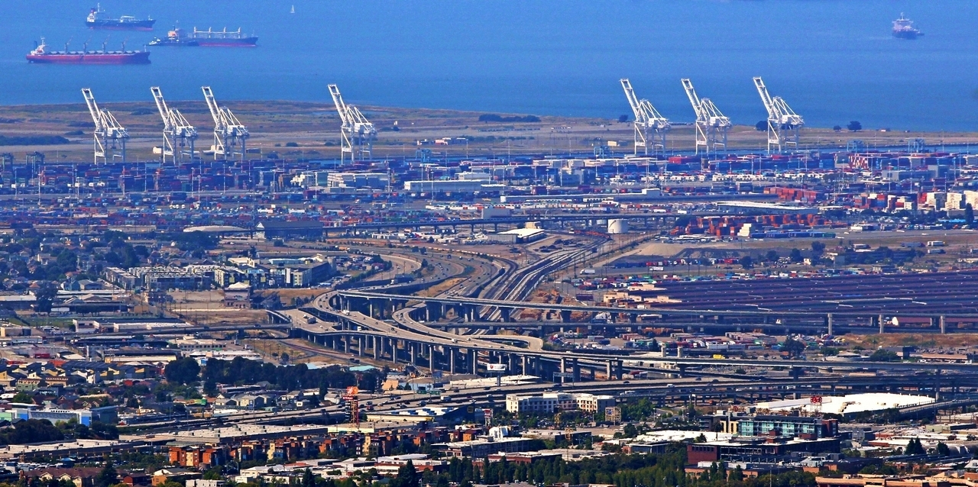
Understanding Biases and Error
13 Apr 2017
Dr. Greg Erhardt
greg.erhardt@uky.edu CE599-002 Spring 2017

Slide 2
Some thoughts on biases and errors
Random Error
Measurement error
Random sampling error
Systematic Error
Selection bias
Information bias
Confounding
Aggregation bias
Examples
Survey Data & Big Data…

Slide 3
Error: As defined in epidemiology
A false or mistaken result obtained in a study or experiment
Random error is the portion of variation in measurement that has no apparent connection to any other measurement or variable, generally regarded as due to chance
Systematic error which often has a recognizable source, e.g., a faulty measuring instrument, or pattern, e.g., it is consistently wrong in a particular direction
Source: U. Sharma
https://www.slideshare.net/jamesmacroony/bias-and-errors?next_slideshow=1

Slide 4
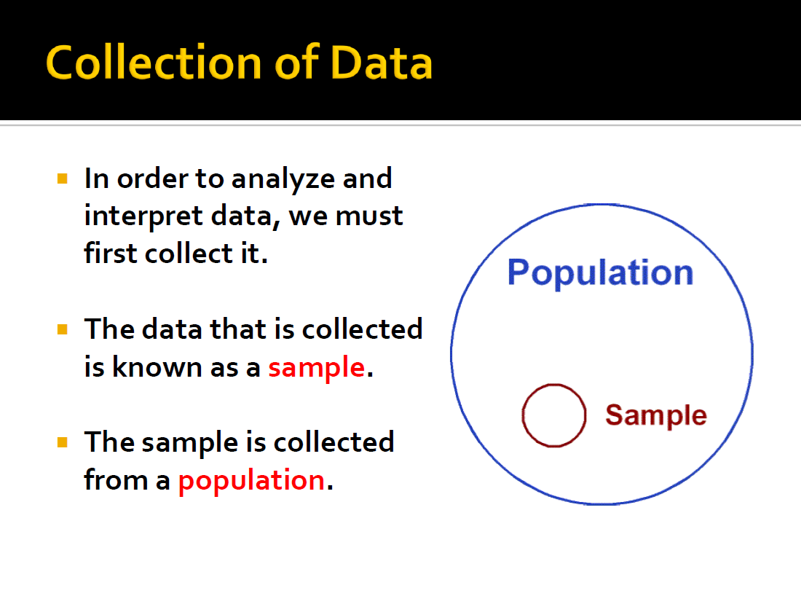
Data Collection
Source: https://cseweb.ucsd.edu/~ricko/CSE3/Lie_with_Statistics.pdf

Slide 5
Random Sampling Error
The mean of one sample is different than the mean of the population
Can occur even when the sample is representative
Classical statistics are good at measuring these with confidence intervals
Transit Riders
What happens when we care about a sub-population?

Slide 6
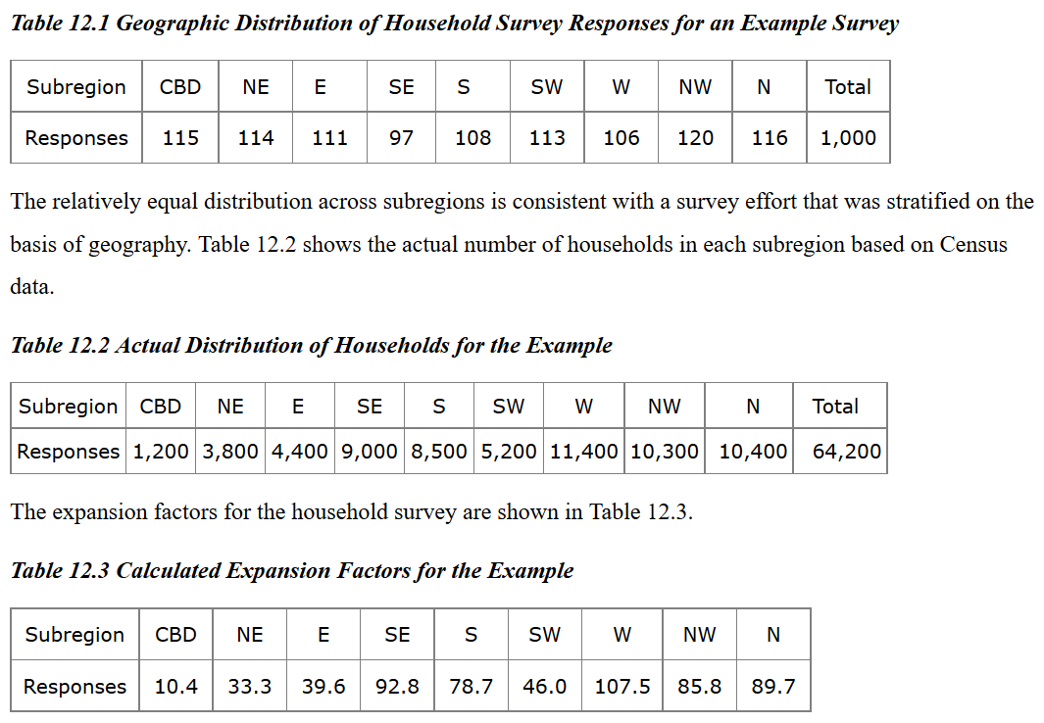
Survey Weighting & Expansion
Ruegg: http://www.travelsurveymanual.org/Chapter-12-1.html
Notes:
Expansion factor is the ratio between the number of households in a certain district (ex. CBD) verses the total number of houses.

Slide 7
Selection bias
Selection bias is a type of bias caused by choosing non-random data for statistical analysis.
Non-response bias occurs because individuals who do not respond to a survey are different from those who do respond.
Who is more likely fill out a travel survey?
A single working mother, or a retired person?

Slide 8
Selection bias
Selection bias is a type of bias caused by choosing non-random data for statistical analysis.
Sampling frame bias occurs because the sampling frame excludes certain individuals
Determine air travel behavior by analyzing frequent flyer records.

Slide 9
Information bias
Information bias is due to systematic measurement error or misclassification of subjects on one or more variables.
Interviewer Bias – misleading or poorly structured questions
Recall Bias – those with a particular outcome or exposure may remember events more clearly or amplify their recollections
Hawthorne effect – an effect first documented at a Hawthorne manufacturing plant; people act differently if they know they are being watched

Slide 10
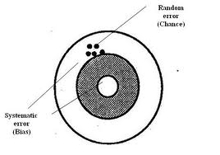
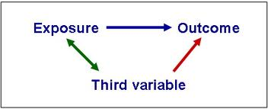
Bias and Confounding
Bias creates an association that is not true, but confounding describes an association that is true, but potentially misleading.
Source: U. Sharma
https://www.slideshare.net/jamesmacroony/bias-and-errors?next_slideshow=1

Slide 11
Example of Confounding
Socio-economic Factors
Income
Age
Occupation
Cohort
Air Travel
Frequency & Scheduling
Destination
Mode
Tech Availability
Level 1
Level 2
Level 3
Level 4
Tech Adoption and Engagement
Do I have it?
Do I use it?

Slide 12
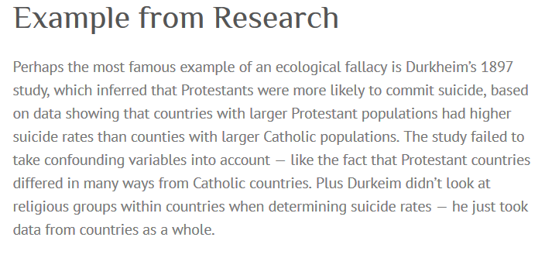
Aggregation Bias
Models estimated on aggregate data can produce biased results
Can lead to the Ecological Fallacy

Slide 13
Aggregation Error Example: Value of Time
Erhardt, G.D., B. Charlton, J. Freedman, J. Castiglione, and M. Bradley. 2008. “Enhancement and Application of an Activity-Based Travel Model for Congestion Pricing.” In Transportation Research Board Innovations in Travel Modeling Conference, Portland, Oregon.

Slide 14
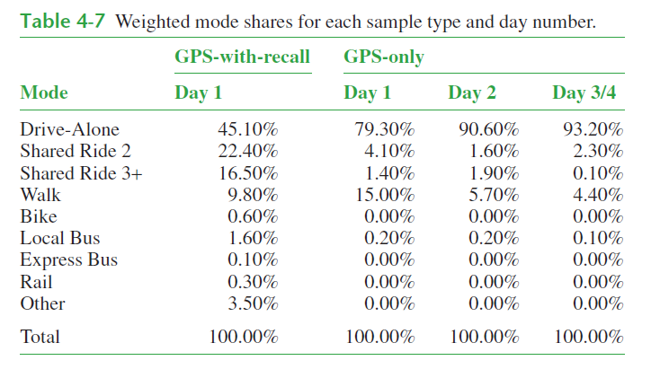
What kind of error?

Slide 15
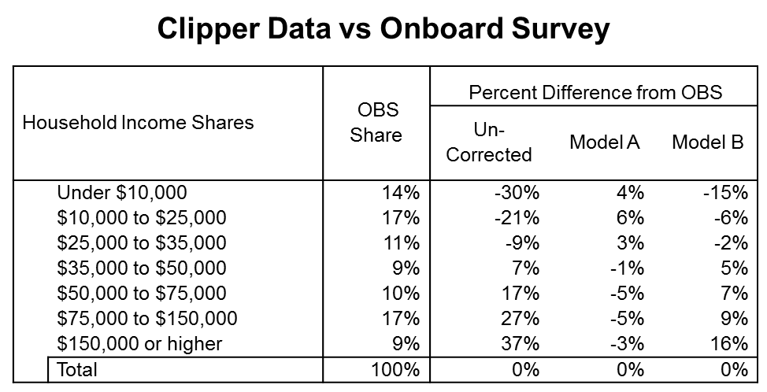
What kind of error?

Slide 16
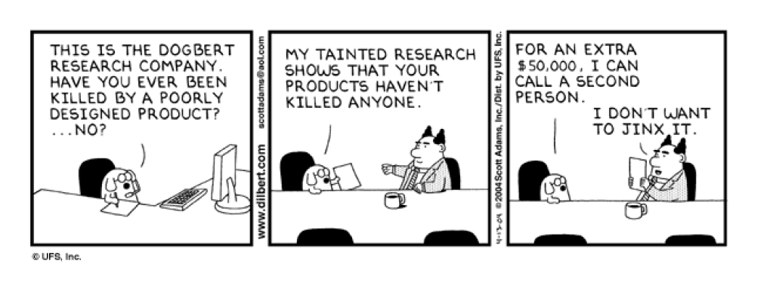
What kind of error?

Slide 17
What kind of error?
“Oh, don’t worry! I did that when I was a kid and I turned out just fine.”

Slide 18
What kind of error?
Prior to earthquakes, animals have been known to behave strangely. Rats run in the streets, dogs howl, and pigs run in circles.

Slide 19
Question
What do you need to understand whether your data are accurate?

Slide 20
Big Data – Distinguishing Factors
Volume
Data Structures
Velocity
Data Chronicity
Intended Purpose
Johnson, Timothy P., and Tom W. Smith. “Big Data and Survey Research: Supplement or Substitute?” In Seeing Cities Through Big Data, edited by Piyushimita (Vonu) Thakuriah, Nebiyou Tilahun, and Moira Zellner, 113–25. Springer Geography. Springer International Publishing, 2017.

Slide 21
Relative Advantages
Big Data
Cost
Timeliness
Completeness
Survey Data
Role of theory
Ease of analysis
Measurement error
Population coverage
Ethical oversight
Transparency
Johnson, Timothy P., and Tom W. Smith. “Big Data and Survey Research: Supplement or Substitute?” In Seeing Cities Through Big Data, edited by Piyushimita (Vonu) Thakuriah, Nebiyou Tilahun, and Moira Zellner, 113–25. Springer Geography. Springer International Publishing, 2017.

Slide 22
Complementary roles?
Big Data
More complete, but less rich
Potential bias
Survey Data
More rich, but less complete
Potential bias
Weighting & expansion to leverage both

Slide 23
Project Objectives
“The objective of this study is to develop a process to analyze and improve the accuracy, reliability, and utility of project-level traffic forecasts.”
-- NCHRP 08-110 RFP
Accuracy is the measure of how well the forecast estimates actual project outcomes.
Reliability is the likelihood that someone repeating the forecast will get the same result.
Utility is how well the projected outcome informs a decision.

